Slide 1
Webinar Agenda
1:00 Welcome and relevance - Maria Cardiellos (Executive Director, IJIS)
1:10 Introduction to the new NIEMOpen – Katherine Escobar (PGB Chair)
1:20 The New NIEM
New NIEM Model Version 6.0 – Dr. Scott Renner (NTAC Co-Chair)
CMF/CMF Tool ( includes demo) – Dr. Scott Renner (NTAC Co-Chair)
API 2.0 – Dr. Scott Renner (NTAC Co-Chair)
NDR 6.0 and toolkit + future updates – Dr. Scott Renner (NTAC Co-Chair)
1:50 Future Architecture, role of Ontologies, and AI - Brad Bolliger (NTAC Co-Chair)
2:00 The future of NIEMOpen with OASIS – Jim Cabral (Acting Director OASIS)
2:10 NIEM on the ground – Maria Cardiellos (Executive Director, IJIS) TBD
2:20 New dimensions for NIEMOpen in ontologies – Carolyn Staats (Sonoma County)
2:30 The future, plans and resources – Katherine Escobar (PGB Chair)
2:35 Q&A (panel with Katherine Escobar, Maria Cardiellos, NBAC and NTAC Co-chairs)
3:-00 Close

Slide 2
Webinar Introduction to the “new” NIEM Open Project 22 May 2025
Stephen Sullivan

Slide 3
Introduction to the new NIEMOpen
As NIEM celebrates its 20th anniversary its worth spending a little time reflecting on how far we’ve come:
Timeline image

Slide 4


















current sponsors
S&T
APN
S&T
Potential future sponsors
DHS OBIM
Department of National Defense
Notes:
11 Sponsors, 3 Premier: JS J6, DHS S&T, CJIS (FBI)
GTRI, Equivant, NAJIS, IJIS, DOT, ODGA (Virginia), BJS, NIJ
In Discussions: Microsoft, DHS OBIM, DND, Canada, DOJ
Expressed Interest: MITRE, EY (Ernst & Young), DISA

Slide 5
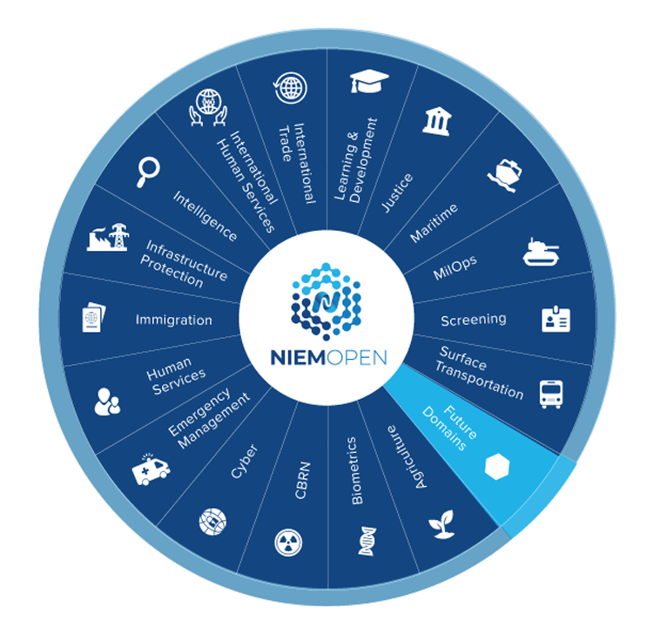
DOMAINS
17 Domains Plus Core
3 Domains in the Offing
Forensics
Analytical Laboratories
Identity Management
Other Interested Parties
DISA
NATO

Slide 6

What OASIS OPEN PROJECT Brings to NIEM?
NIEM Open Project recognized as accredited standard
Improves International adoption
Preference to accredited standards
Increased scalability and keeps pace with speed of innovations in data technologies and standardization to accelerate adoption and public-private exchange/interoperability
Sustainable
Aligns with Government Policy/Process/Procedure
Open Standard removes barriers – industry hesitation to participate, conflict of interest concern

Slide 7
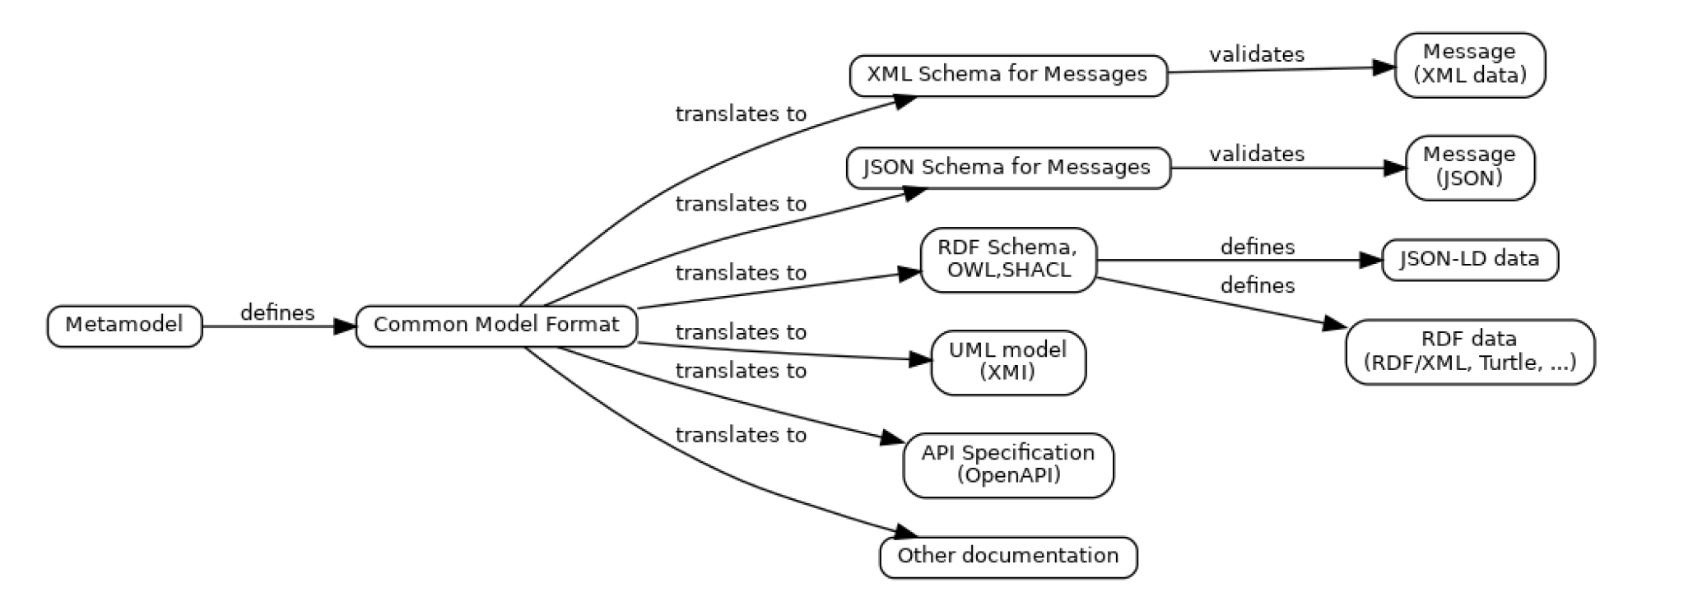
NIEM in the 21st century
Common Model Format (CMF)
NIEM has always used XML Schema as its data modeling language
Model semantics formally defined via mappings to Resource Description Framework (RDF)
Mappings defined in the Naming and Design Rules
Convenient for designers and developers implementing XML-based data exchange
NIEM now supports developers who aren’t using XML
XML Schema is not convenient for them
For NIEM 6, we created the NIEM metamodel and Common Model Format
Metamodel: A conceptual data model for the things we want to know about data models
CMF: A NIEM-based implementation of the metamodel… Just like any IEPD

Slide 8

Leaning forward into the future
Official Standard
New Architecture
New Model
New Design Rules
New Tools & APIs
New Training/Learning Management System
Embracing New Technologies
AI
Knowledge Graphs
Ontologies
Support for Other Standards
Outreach to Industry and International Partners

Slide 9
Webinar NIEMOpen Future 22 May 2025
Stephen Sullivan

Slide 10

The NIEMOPEN Future
Why Choose NIEMOpen
Recognized Standard
Flexible & Adaptable Architecture
Robust AI Support
Host for Emerging Technologies
World Class Accredited Training
Cutting Edge Tools
International Footprint
Industry and Government Choice
Expanding Community of Interest
Sustainable Infrastructure & Growth

Slide 11





Resources/CONTACT US
Git Repos
github.com/NIEM/NIEM.github.io
NIEMOpen: github.com/niemopen
NTAC TSC (admin): github.com/niemopen/ntac-admin
NBAC TSC (admin): …/nbac-admin
NMO TSC (admin): …/nmo-admin
oasis-open.org
niempen.org
niem.gov/
Groups & Mailing Lists
NIEMOpen: lists.oasis-open-projects.org/g/niemopen
NTAC TSC: .../niemopen-ntactsc
NBAC TSC: .../niemopen-nbactsc
NMO TSC: .../niemopen-nmotsc
Latest Model Specification v6.0 PS02
GitHub - niemopen/niem-model: The NIEM reference data model
On the Website, select an option for access:
Notes:
Beth Smalley

